Slide 1
Scratch workbook

Slide 2
Overview
0 - Getting Started 1 - Exploring 2 - Animations 3 - Stories 4 - Games 5 - Diving Deeper 6 - Hackathon
Notes:
Mentors guide http://scratched.gse.harvard.edu/guide/files/CreativeComputing20141015.pdf

Slide 3
GETTING STARTED
VIDEO
0
https://www.youtube.com/watch?v=-SjuiawRMU4&feature=youtu.be
SCRATCH ACCOUNT
SCRATCH SURPRISE
SCRATCH STUDIO

Slide 4
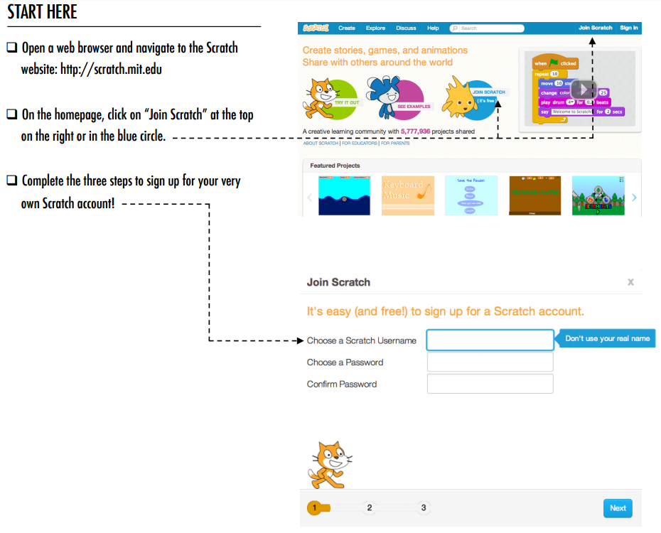
SCRATCH ACCOUNT
GETTING STARTED
NEW TO SCRATCH? GET STARTED BY CREATING YOUR SCRATCH ACCOUNT!
You will need a Scratch account to create, save, and share your Scratch projects. The steps on the right hand side will walk you through creating a new account and setting up your profile.
Links:
https://scratch.mit.edu/
Notes:
https://scratch.mit.edu/community_guidelines
Scratch online accounts require an email address. If students cannot provide a personal or school email address, a teacher or parent/guardian email address may be used. Plan in advance if permission slips for online accounts need to be collected. !
Help students navigate to the Scratch website at http://scratch.mit.edu and click on “Join Scratch” to get started creating a Scratch account. Optionally, have the Scratch Account handouts available to guide students. Give students time to register, update their Scratch profile page, and explore the Scratch online community. Encourage students to practice signing in and out of their accounts. !
To make it easier for members of the class to find and follow one another’s Scratch profiles, consider creating a class list of usernames and names.
Examine the Scratch community guidelines as a group to discuss respectful and constructive behavior. Review how to report inappropriate posts on the website

Slide 5
SCRATCH ACCOUNT - hints
GETTING STARTED
+What is your Scratch account username?
+What is a hint to help you remember your password?

Slide 6
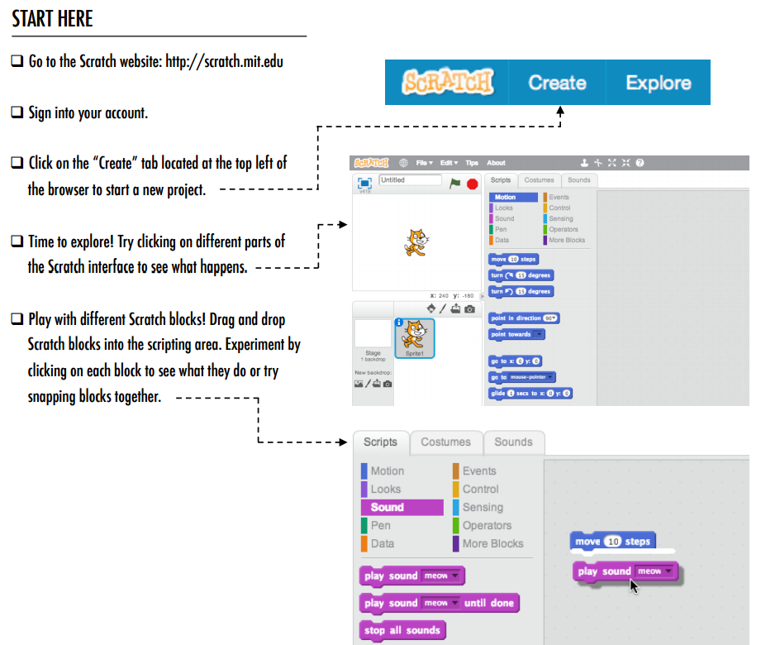
SCRATCH SURPRISE
GETTING STARTED
CAN YOU MAKE THE SCRATCH CAT DO SOMETHING SURPRISING?
In this activity, you will create a new project with Scratch and explore different Scratch blocks to make the cat do something surprising! What will you create?
Follow the steps on the right, use scratch cards to learn more about Scratch code.
Links: https://scratch.mit.edu/ Scratch cards
TIP:
Use scratch cards to quickly learn new Scratch code
Notes:
Help students open the Scratch project editor by navigating to the Scratch website at http://scratch.mit.edu, signing in to their Scratch accounts, and then clicking on “Create”at the top of the page. Optionally, have the Scratch Surprise handout and Scratch Cardsavailable to guide students during their explorations.

Slide 7
SCRATCH SURPRISE - Reflections
GETTING STARTED
+What did you figure out?
+What do you want to know more about?

Slide 8
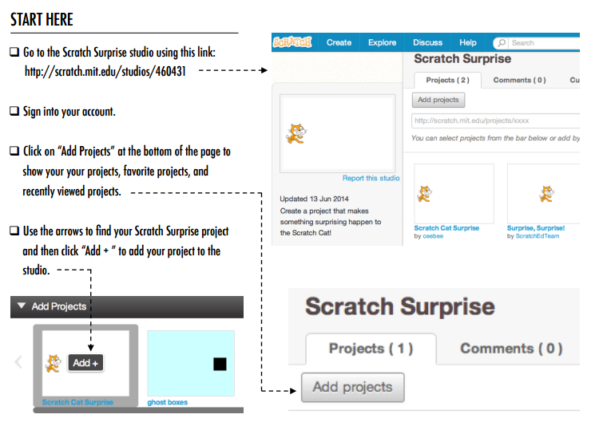
SCRATCH
STUDIO
GETTING STARTED
LEARN HOW TO ADD YOUR PROJECT TO AN ONLINE SCRATCH STUDIO!
Studios are collections of Scratch projects. Follow along with the ‘START HERE’ steps to add your Scratch Surprise program to the Scratch Surprise studio on the Scratch website.
Links: SCRATCH STUDIO
Notes:
OBJECTIVES By completing this activity, students will:
+ be able to add a project to a studio
+ be able to post comments on other Scratch projects
Scratch studios are one way to collect and organize Scratch projects online. In this activity, help students understand what studios are and how to add a project to a studio. Optionally, have the Scratch Studio handout available to guide students. !
First, have students navigate to the Scratch website and sign in to their accounts. Next, help students find the Scratch Surprise studio or a class studio you’ve created. Then, let students share their Scratch Surprise explorations with others by adding their programs to the studio.
Encourage students to investigate other projects in the studio. Invite them to add a comment on the project page of two projects in the collection that they find particularly interesting or inspiring. Engage the group in a discussion about how to give appropriate and purposeful feedback.
Ask students to think back on their creative explorations by responding to the reflection prompts in their design journals or in a group discussion.

Slide 9
SCRATCH STUDIO- Reflections
GETTING STARTED
+What are Scratch studios for?
+What did you find interesting or inspiring about looking at other projects?
+What two comments did you share?
+What is “good” feedback?

Slide 10
1 - EXPLORING
1
STEP-BY-STEP
10 BLOCKS
MY STUDIO
DEBUG IT!
ABOUT ME
From a step-by-step tutorial, to playing with a constrained number of blocks, to a debugging challenge, each activity helps learners build the skills needed to create an About Me project.
In the culminating project, learners will explore and experiment with sprites, costumes, looks, backdrops, and sounds to create a personalized, interactive collage in Scratch.

Slide 11
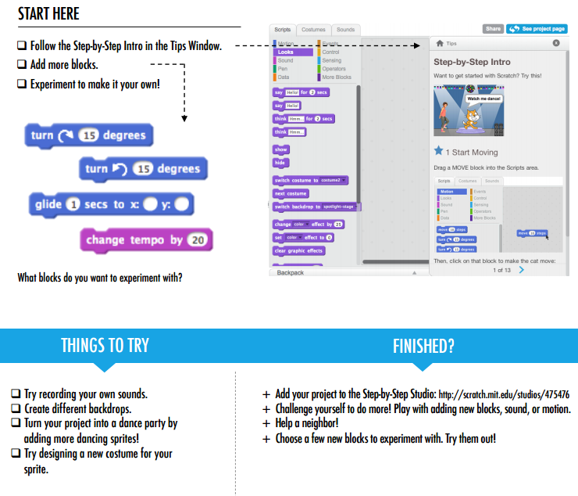
STEP-BY-STEP
GETTING STARTED
NEW TO SCRATCH? CREATE YOUR FIRST SCRATCH PROJECT!
In this activity, you will follow the Step-by-Step Intro in the Tips Window to create a dancing cat in Scratch. Once you have completed the steps, experiment by adding other Scratch blocks to make the project your own.
Links:
Add your project to the Step By Step Studio
Notes:
OBJECTIVES
By completing this activity, students will:
+ create a dancing cat in Scratch by following a step-bystep tutorial
+ experience building up a program by experimenting and iterating
REVIEW
+ Were students able to open Scratch and find the Tips Window?
+ Were students able to create a dancing cat?
+ Were students able to save and share projects?

Slide 12
STEP-BY-STEP - reflections
Unit 1 - EXPLORING
+What was surprising about the activity?
+How did it feel to be led step-by-step through the activity?

Slide 13
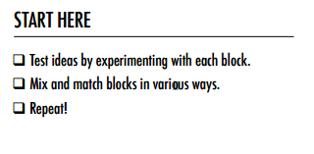
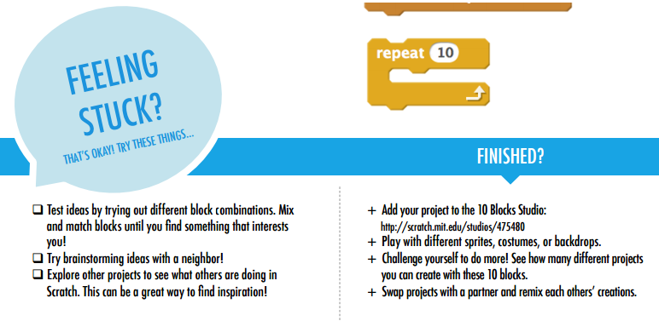
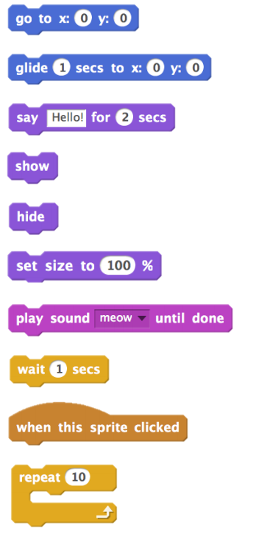
10 BLOCKS
GETTING STARTED
WHAT CAN YOU CREATE WITH ONLY 10 SCRATCH BLOCKS?
Create a project using only these 10 blocks. Use them once, twice, or multiple times, but use each block at least once.
Links:
https://scratch.mit.edu/projects/editor/?tip_bar=home
10 Blocks Studio
Notes:
OBJECTIVES
By completing this activity, students will:
+ create a project with the constraint of only being able to use 10 blocks

Slide 14
10 BLOCKS- Reflections
Unit 1 - EXPLORING
+What was difficult about being able to use only 10 blocks?
+What was easy about being able to use only 10 blocks?

Slide 15
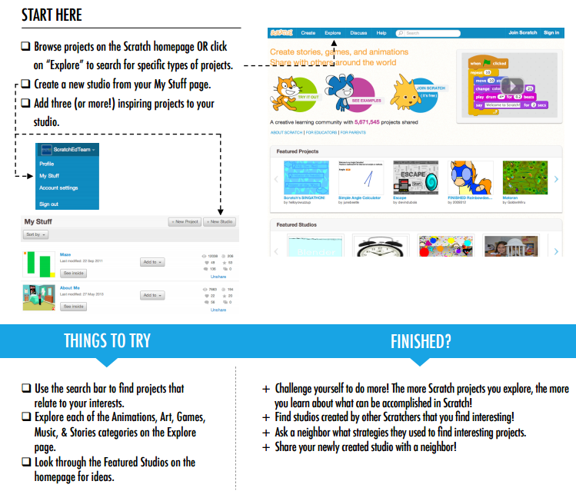
MY STUDIO
GETTING STARTED
WHAT CAN BE CREATED WITH SCRATCH?
In this activity, you will investigate the range of creative possibility with Scratch by exploring some of the millions of projects on the Scratch website -- and start a collection of favorites in a Scratch studio!
Follow the steps on the right
Links: https://scratch.mit.edu/
Notes:
OBJECTIVES
By completing this activity, students will:
+ investigate the range of creative possibilities with Scratch by exploring some of the millions of projects on the Scratch website
+ curate a collection of 3 or more Scratch projects in a Scratch studio
Ask students to identify three or more Scratch projects that can be used to inform and inspire a project of their own. Help students create a new studio from their My Stuff page and add the inspirational projects to the studio

Slide 16
MY STUDIO - Reflections
Unit 1 - EXPLORING
+What search strategies did you use to find interesting projects?
+How might each example project help with future work?

Slide 17
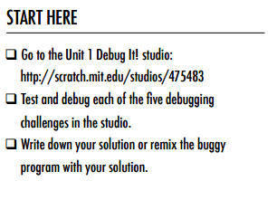
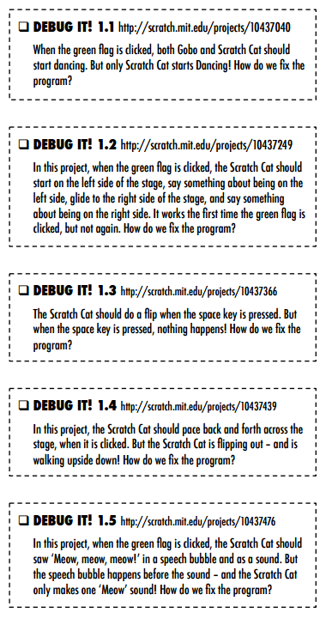
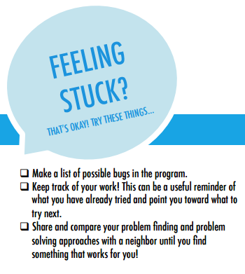
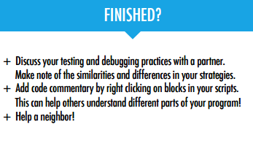
DEBUG IT!
HELP! CAN YOU DEBUG THESE FIVE SCRATCH PROGRAMS?
In this activity, you will investigate what is going awry and find a solution for each of the five Debug It! challenges.
Links: START HERE
Debug 1.1 Debug 1.2 Debug 1.3 Debug 1.4 Debug 1.5
Notes:
OBJECTIVES
By completing this activity, students will:
+ investigate the problem and find a solution to five debugging challenges
+ explore a range of concepts (including sequence) through the practices of testing and debugging
+ develop a list of strategies for debugging projects

Slide 18
DEBUG IT!- Reflections
Unit 1 - EXPLORING
+What was the problem?
+How did you fix the problem?
+How did you identify the problem?
+How else could you have fixed the problem?

Slide 19
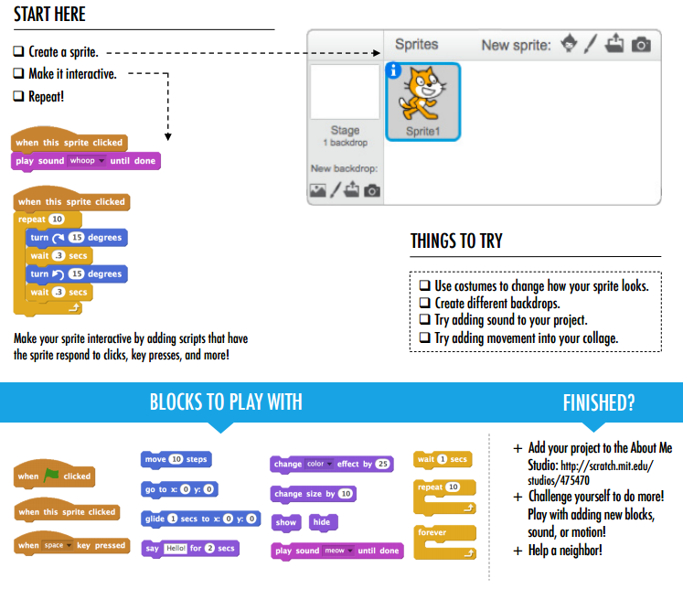
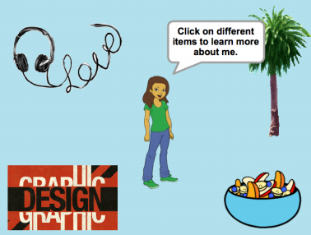
ABOUT ME
HOW CAN YOU COMBINE INTERESTING IMAGES AND SOUNDS TO MAKE AN INTERACTIVE COLLAGE ABOUT YOURSELF?
Experiment with sprites, costumes, backdrops, looks, and sounds to create an interactive Scratch project -- a project that helps other people learn more about YOU and the ideas, activities, and people that you care about.
Links: START HERE About me Studio
Notes:
OBJECTIVES
By completing this activity, students will:
+ become familiar with a wider range of Scratch blocks
+ be able to create an open-ended Scratch project that is an interactive digital representation of their personal interests

Slide 20
ABOUT ME- Reflections
Unit 1 - EXPLORING
+What are you most proud of? Why?
+What might you want to do next?
+What did you get stuck on? How did you get unstuck?
+What did you discover from looking at others’ About Me projects?

Slide 21
2 - ANIMATIONS
2
BUILD-A-BAND
ORANGE SQUARE, PURPLE CIRCLE
IT’S ALIVE!
DEBUG IT!
MUSIC VIDEO
From a step-by-step tutorial, to playing with a constrained number of blocks, to a debugging challenge, each activity helps learners build the skills needed to create an About Me project.
In the culminating project, learners will explore and experiment with sprites, costumes, looks, backdrops, and sounds to create a personalized, interactive collage in Scratch.

Slide 22
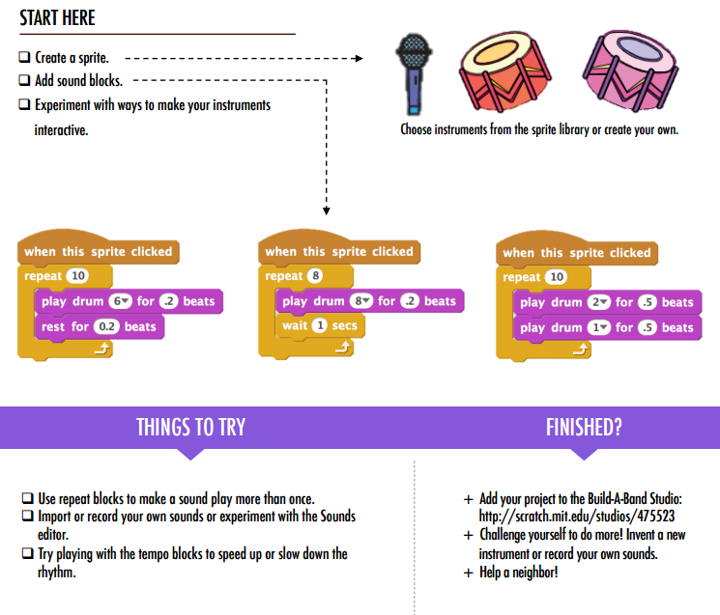
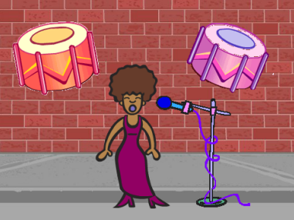
BUILD A BAND
HOW CAN YOU UTILIZE SCRATCH TO CREATE SOUNDS, INSTRUMENTS, BANDS, OR STYLES OF MUSIC THAT REPRESENT THE MUSIC YOU LOVE MOST?
In this activity, you will build your own music-inspired Scratch project by pairing sprites with sounds to design interactive instruments
Links: Build a Band STUDIO
Notes:
OBJECTIVES
By completing this activity, students will:
+ create a program that combines interactive sprites with interesting sounds
+ develop greater fluency with sequence, loops, events, and parallelism
+ practice experimenting and iterating in building up project creations
Reviewing project
+ Do projects make creative use of sounds?
+ Are the sprites in the projects interactive?

Slide 23
BUILD A BAND- Reflections
Unit 2 - ANIMATIONS
+What did you do first?
+What did you do next?
+What did you do last?
+What did you discover from looking at others’ Build a Band projects?

Slide 24
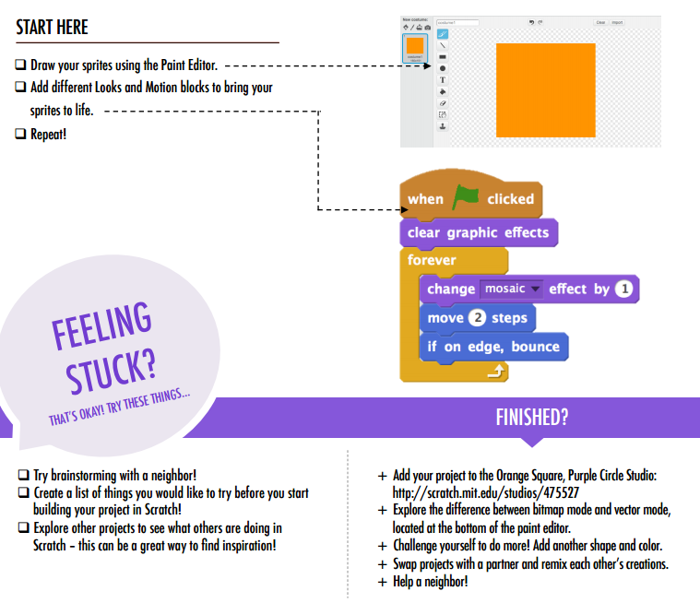

ORANGE SQUARE, PURPLE CIRCLE
WHAT PROJECT CAN YOU CREATE THAT INCLUDES AN ORANGE SQUARE AND A PURPLE CIRCLE?
In this challenge, you’ll create a project that includes an orange square and a purple circle. What will you create?
Links: Orange Square, Purple Cicrle Studio
Notes:
OBJECTIVES
By completing this activity, students will:
+ express their creativity by completing an arts-themed challenge
+ gain more fluency with Looks blocks and the paint editor
Reviewing project
+ Do projects include an orange square and a purple circle?

Slide 25
ORANGE SQUARE, PURPLE CIRCLE REFLECTIONS - Reflections
Unit 2- ANIMATIONS
+How did you incorporate an orange square and a purple circle into your project? Where did this idea come from?
+What was challenging about this activity?

Slide 26
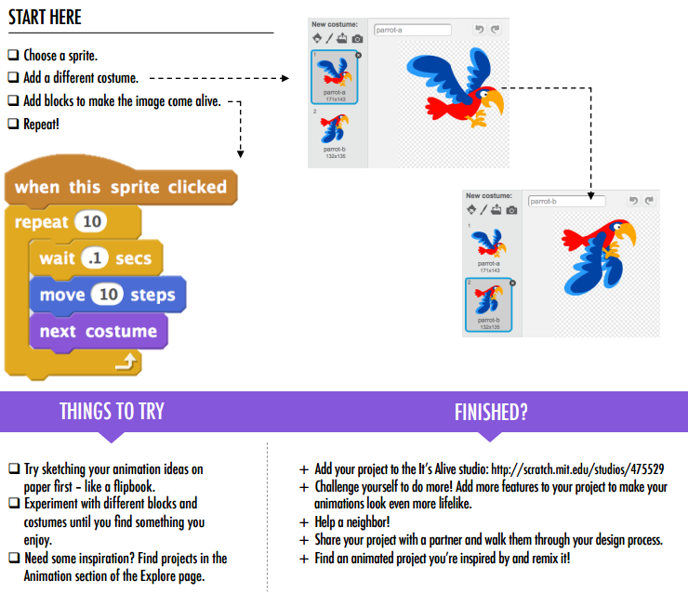
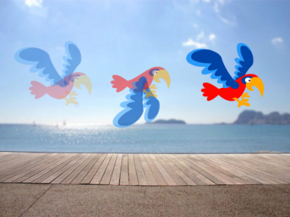
IT’S ALIVE
HOW CAN YOU TAKE AN IMAGE OR A PHOTO AND MAKE IT COME ALIVE?
In this activity, you will explore ways of bringing sprites, images, and ideas to life as an animation by programming a series of costume changes.
Links: It's Alive Studio
Notes:
OBJECTIVES
By completing this activity, students will:
+ become more familiar with the computational concepts of sequence and loops by experimenting with Control blocks
+ be able to explain the difference between sprites and costumes
+ practice experimenting and iterating through developing an animation project
Reviewing project
+ Can students distinguish sprites and costumes?
+ Some Scratchers are particularly interested in developing animation projects and prefer to spend their time drawing and designing sprites, costumes, or backdrops. How might you engage students in both the aesthetic and technical aspects of projects?

Slide 27
IT’S ALIVE - Reflections
Unit 2- ANIMATIONS
+What is the difference between a sprite and a costume?
+List three ways you experience loops in real life (e.g., going to sleep every night).

Slide 28
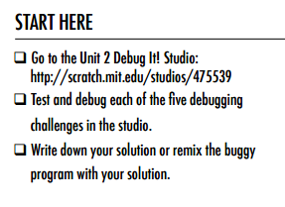
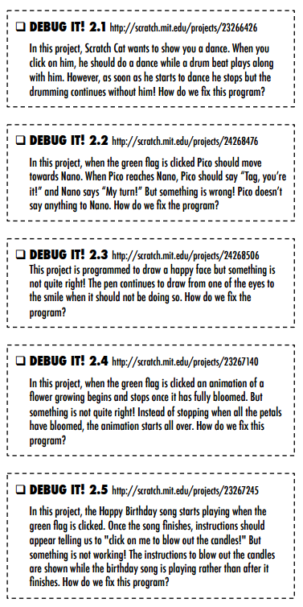
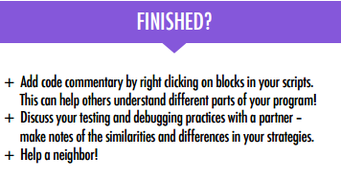
DEBUG IT!
HELP! CAN YOU DEBUG THESE FIVE SCRATCH PROGRAMS?
In this activity, you will investigate what is going awry and find a solution for each of the five Debug It! challenges.
Links: START HERE
Debug 2.1 Debug 2.2 Debug 2.3 Debug 2.4 Debug 2.5
Notes:
OBJECTIVES
By completing this activity, students will:
+ investigate the problem and find a solution to five debugging challenges
+ explore a range of concepts (including sequence) through the practices of testing and debugging
+ develop a list of strategies for debugging projects

Slide 29
DEBUG IT!- Reflections
Unit 2 - ANIMATIONS
+What was the problem?
+How did you fix the problem?
+How did you identify the problem?
+How else could you have fixed the problem?

Slide 30
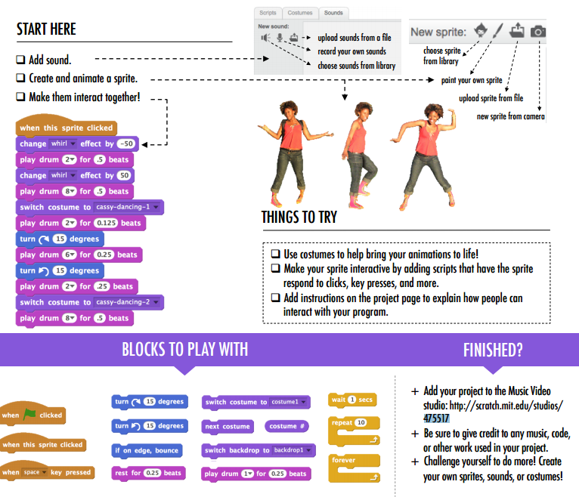
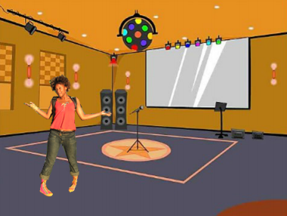
MUSIC VIDEO
HOW CAN YOU COMBINE ANIMATION WITH MUSIC TO CREATE YOUR OWN SCRATCH-INSPIRED MUSIC VIDEO?
In this project, you will explore ideas related to theatre, song, dance, music, drawing, illustration, photography, and animation to create a personalized music video!
Links: Music Video Studio
Notes:
OBJECTIVES
By completing this activity, students will:
+ be able to create a project that combines animation and music by working on a self-directed music video project
+ gain more familiarity with sprites, costumes, and sounds
Reviewing project
+ Did the projects combine sprites and sound?
+ What parts of the projects did students choose to animate?
+ Are there certain blocks or concepts introduced up until now that students might still be struggling with? How might you help?

Slide 31
MUSIC VIDEO - Reflections
Unit 2- ANIMATIONS
+What was a challenge you overcame? How did you overcome it?
+What is something you still want to figure out?

Slide 32
3 - STORIES
3
CHARACTERS
CONVERSATIONS
SCENES
DEBUG IT!
CREATURE CONSTRUCTION
PASS IT ON

Slide 33
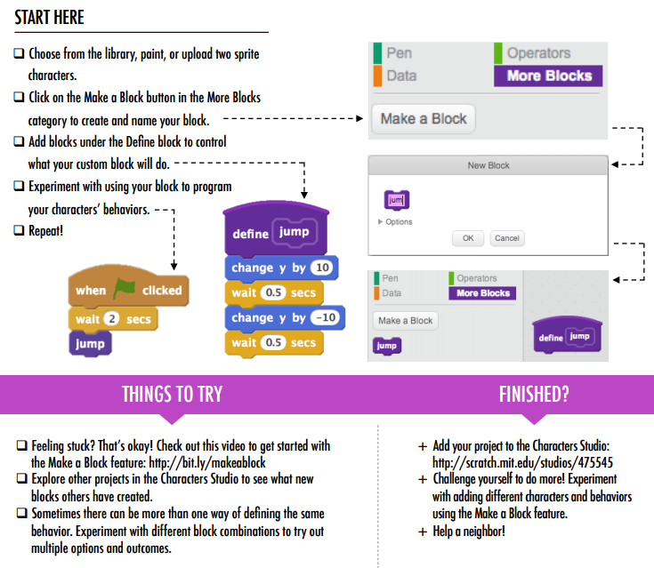
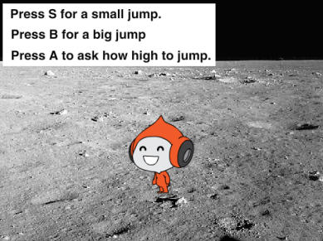
CHARACTERS
DO YOU WANT TO CREATE YOUR OWN SCRATCH BLOCKS?
Experiment with the Make a Block feature in Scratch! In this project, you will create your own blocks that define two behaviors for two different characters.
Links: Characters Studio Make a block video
Notes:
OBJECTIVES
By completing this activity, students will:
+ experiment with defining behaviors for characters using Scratch’s Make a Block feature
+ gain more familiarity with the computational concepts of events and parallelism and the practice of experimenting and iterating
Reviewing project
+ Do projects include two sprites that each have two behaviors using the Make a Block feature?
+ Can students explain how to use the Make a Block feature to each other and to you?

Slide 34
CHARACTERS - Reflections
Unit 3- STORIES
+How would you explain Make a Block to someone else?
+When might you use Make a Block?

Slide 35
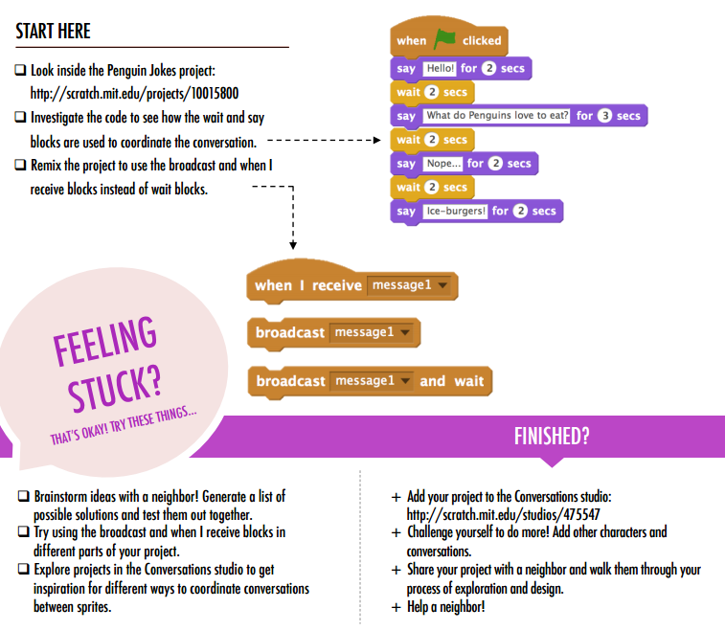
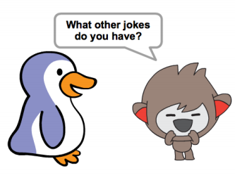
CONVERSATIONS
WHAT ARE DIFFERENT WAYS TO COORDINATE INTERACTIONS BETWEEN SPRITES?
In this activity, you'll explore different ways to program sprites to have conversations! Experiment with timing and explore using broadcast by remixing a joke project.
Links: Conversations Studio Penguin Jokes
Notes:
OBJECTIVES
By completing this activity, students will:
+ explore two different strategies for synchronizing interactions between sprites (timing and broadcasting) by remixing a joke project
+ develop greater familiarity with the computational concept of events and parallelism and the practice of reusing and remixing
Reviewing project
+ Do projects use the broadcast and when I receive blocks?
+ Can students explain how to use the broadcast, broadcast and wait, and when I receive blocks?

Slide 36
CONVERSATIONS- Reflections
Unit 3- STORIES
+How would you describe broadcast to someone else?
+When would you use timing in a project? When would you use broadcasting?

Slide 37
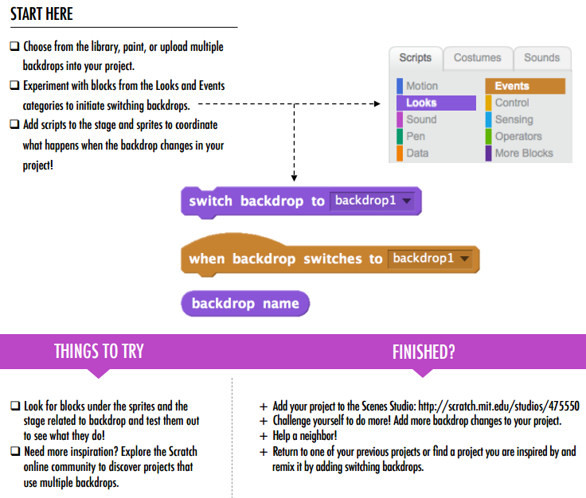
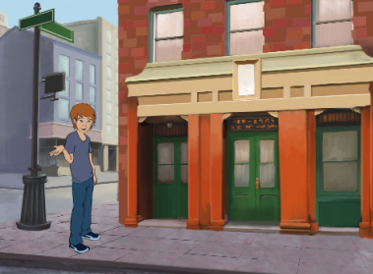
SCENES
WHAT IS THE DIFFERENCE BETWEEN THE STAGE AND SPRITES?
In this activity, you will create a project that experiments with backdrops, like a story with multiple scenes or a slideshow
Links: Scenes Studio
Notes:
OBJECTIVES
By completing this activity, students will:
+ be able to create a project that experiments with changing backdrops, like a story with multiple scenes or a slideshow
+ gain more familiarity with the computational concepts of events and parallelism and the practice of experimenting and iterating
Reviewing project
+ Do projects successfully coordinate multiple scenes using changing backdrops?

Slide 38
SCENES - Reflections
Unit 3 - STORIES
+What does the Stage have in common with sprites?
+How do you initiate a sprite’s actions in a scene?
+How is the Stage different from sprites?
+What other types of projects (beyond animations) use scene changes?

Slide 39
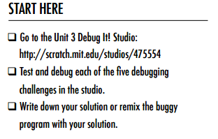
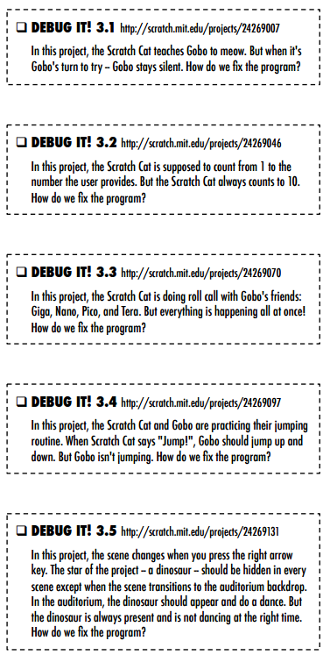
DEBUG IT!
HELP! CAN YOU DEBUG THESE FIVE SCRATCH PROGRAMS?
In this activity, you will investigate what is going awry and find a solution for each of the five Debug It! challenges.
Links: START HERE
Debug 3.1 Debug 3.2 Debug 3.3 Debug 3.4 Debug 3.5
Notes:
OBJECTIVES
By completing this activity, students will:
+ investigate the problem and find a solution to five debugging challenges
+ explore a range of concepts (including sequence) through the practices of testing and debugging
+ develop a list of strategies for debugging projects
REVIEW
+ Were students able to solve all five bugs? If not, how might you clarify the concepts expressed in the unsolved programs?
+ What different testing and debugging strategies did students employ?

Slide 40
DEBUG IT!- Reflections
Unit 3 - STORIES
+What was the problem?
+How did you fix the problem?
+How did you identify the problem?
+How else could you have fixed the problem?

Slide 41
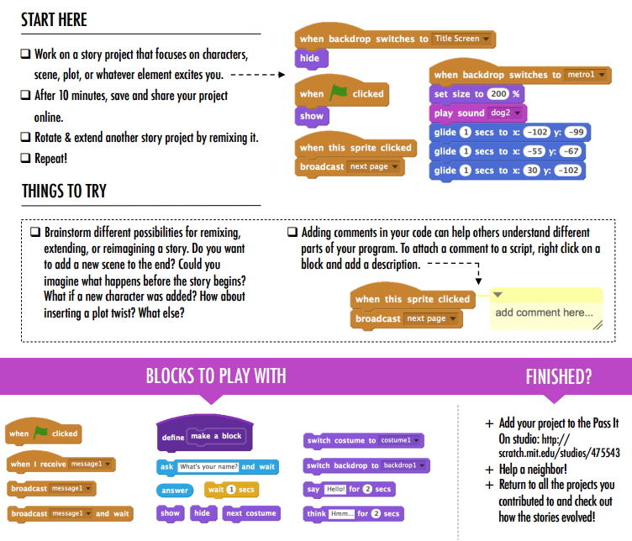
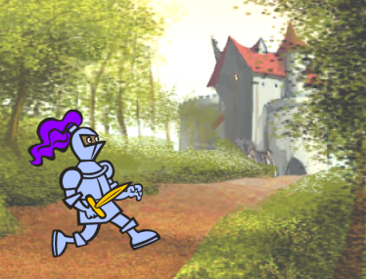
PASS IT ON
WHAT CAN WE CREATE BY BUILDING ON OTHERS’ WORK?
In this project, you will start developing an animated story project, and then you will pass the story on to others to remix, extend, or reimagine!
Links: Pass it on Studio
Notes:
OBJECTIVES
By completing this activity, students will:
+ be introduced to the computational practice of reusing and remixing by contributing to a collaborative drawing
Reviewing project
+ Can students explain remixing and its benefits?

Slide 42
PASS IT ON - Reflections
Unit 3- STORIES
+How did it feel to remix and build on others’ work? How did it feel to be remixed?
+Where else in your life have you seen or experienced reusing and remixing? Share two examples.

Slide 43
4 - GAMES
4
STARTER GAMES
SCORE
EXTENSIONS
INTERACTIONS
DEBUG IT!

Slide 44
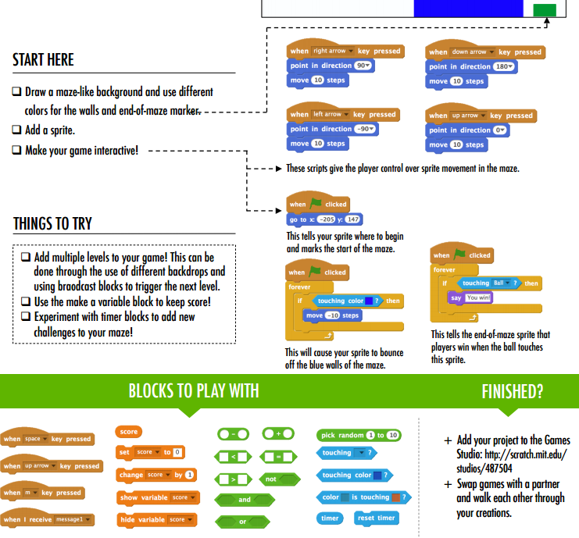

MAZE
HOW CAN YOU USE SCRATCH TO BUILD AN INTERACTIVE GAME?
In this project, you will create a game. This game includes interactions between sprites, score, and levels. You move a sprite from the start of a maze to the end without touching the walls.
Links: Games Studio
Notes:
OBJECTIVES
By completing this activity, students will:
+ be able to create a project that experiments with changing backdrops, like a story with multiple scenes or a slideshow
+ gain more familiarity with the computational concepts of events and parallelism and the practice of experimenting and iterating
Reviewing project
+ Do projects successfully coordinate multiple scenes using changing backdrops?

Slide 45
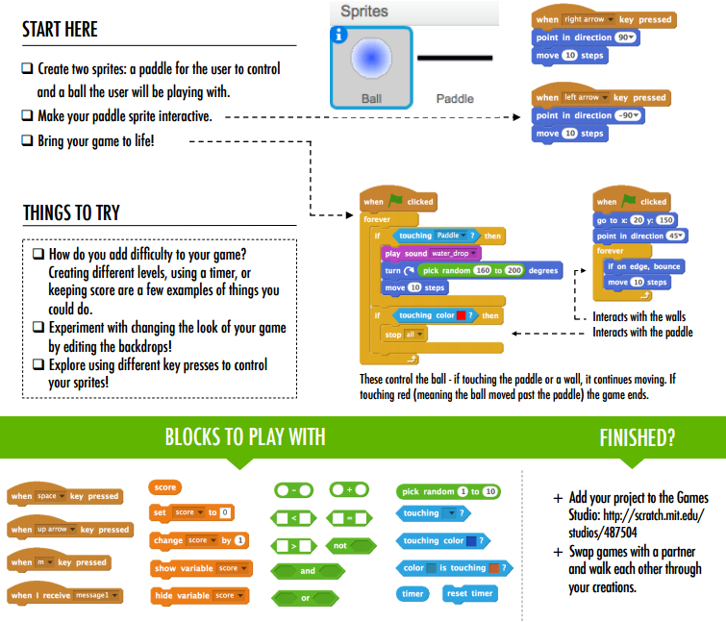
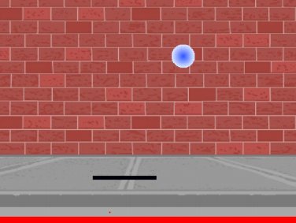
PONG
HOW CAN YOU USE SCRATCH TO BUILD AN INTERACTIVE GAME?
In this project, you will create a game. This game includes interactions between sprites, score, and levels. The game is similar to the classic game of pong, where the goal is to keep the sprite from getting past you.
Links: Games Studio
Notes:
OBJECTIVES
By completing this activity, students will:
+ be able to create a project that experiments with changing backdrops, like a story with multiple scenes or a slideshow
+ gain more familiarity with the computational concepts of events and parallelism and the practice of experimenting and iterating
Reviewing project
+ Do projects successfully coordinate multiple scenes using changing backdrops?

Slide 46
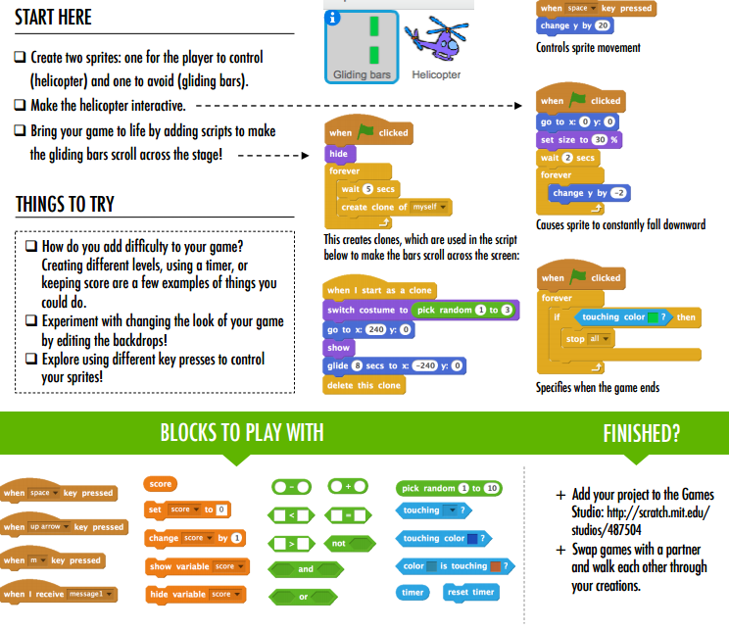
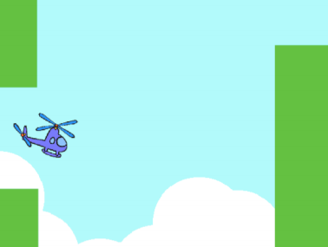
SCROLLING
HOW CAN YOU USE SCRATCH TO BUILD AN INTERACTIVE GAME?
In this project, you will create a game. This game includes interactions between sprites, score, and levels. The game is similar to Flappy Bird, where the goal is to keep an object from falling to the ground or touching certain objects
Links: Games Studio
Notes:
OBJECTIVES
By completing this activity, students will:
+ be able to create a project that experiments with changing backdrops, like a story with multiple scenes or a slideshow
+ gain more familiarity with the computational concepts of events and parallelism and the practice of experimenting and iterating
Reviewing project
+ Do projects successfully coordinate multiple scenes using changing backdrops?

Slide 47
STARTER GAMES - Reflections
Unit 4- GAMES
+What was challenging about designing your game?
+What are you proud of?

Slide 48
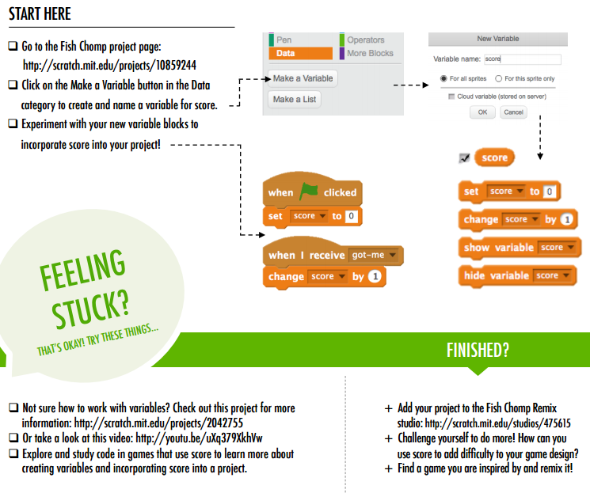
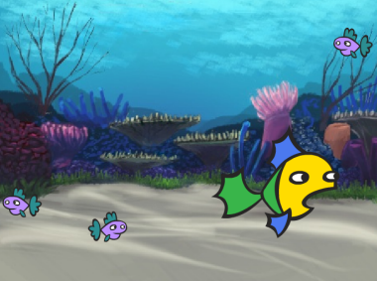
SCORE
HOW CAN YOU KEEP SCORE IN A SCRATCH PROJECT?
Fish Chomp is a game where players try to catch as many fish as they can by guiding a sprite with the mouse. In this activity, you will remix Fish Chomp by adding a score with variables.
Links: Fish Chomp Starter Project Variables & Variables Video Score Examples Fish Chomp Studio
Notes:
OBJECTIVES
By completing this activity, students will:
+ be able to describe what a variable is and why variables are useful
+ be introduced to the computational concept of data
+ experience remixing and reusing a project or part of a project
Reviewing project
+Can students explain what a variable is and what variables are good for?

Slide 49
SCORE - Reflections
Unit 4- GAMES
+How would you explain variables to someone else?
+What are variables good for?

Slide 50
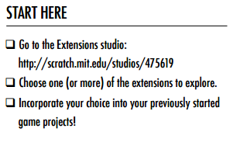
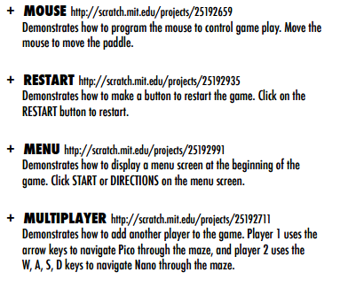
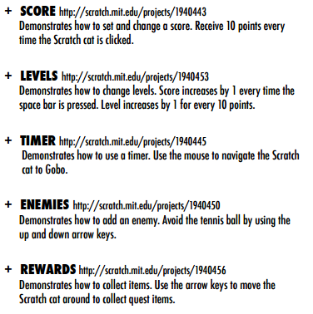
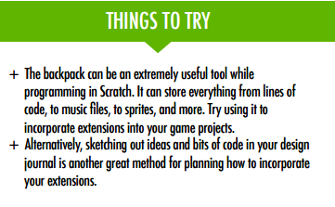
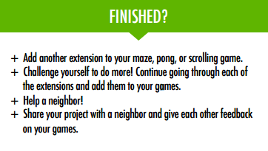
EXTENSIONS
HOW CAN YOU EXTEND AND REIMAGINE GAMES IN SCRATCH?
Get into game design by adding extended features within your Scratch project! Choose at least one (or more!) of the following extensions and add it to your previously started maze, pong, or scrolling games. Links: Extensions Studio
Score
Levels
Timer
Enemies
Rewards
Mouse
Restart
Menu
Multiplayer
Notes:
OBJECTIVES
By completing this activity, students will:
+ become more familiar with the concepts of conditionals, operators, and data by exploring programs that illustrate common game mechanics
Reviewing project
+Were students able to incorporate extensions into their original game projects?

Slide 51
EXTENSIONS- Reflections
Unit 4- GAMES
+What are different ways of increasing difficulty in a game?
+Which extensions did you add to your game project?

Slide 52
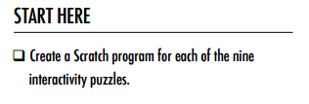
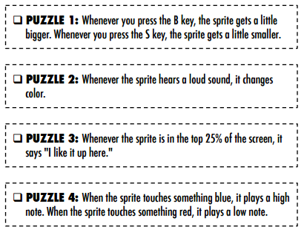
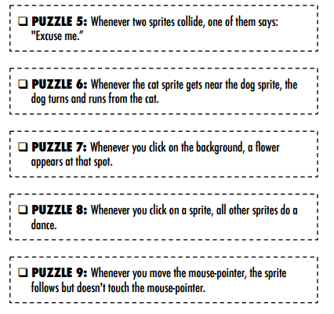
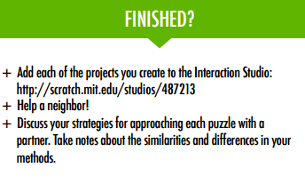
INTERACTIONS
WHAT DIFFERENTIATES A SCRATCH PROJECT FROM A STILL IMAGE OR A VIDEO?
Tackle these nine puzzles that engage some of the more advanced concepts in Scratch related to interactivity. Each of these challenges has several possible solutions. Links: Interactions Studio
Notes:
OBJECTIVES
By completing this activity, students will:
+ become more familiar with the concepts of conditionals, operators, and data by exploring programs that illustrate common game mechanics
Reviewing project
+Were students able to incorporate extensions into their original game projects?

Slide 53
INTERACTIONS - Reflections
Unit 4- GAMES
+Which puzzles did you work on?
+Which puzzles helped you think about your game project?

Slide 54


DEBUG IT!
HELP! CAN YOU DEBUG THESE FIVE SCRATCH PROGRAMS?
In this activity, you will investigate what is going awry and find a solution for each of the five Debug It! challenges.
Links: START HERE
Debug 4.1 Debug 4.2 Debug 4.3 Debug 4.4 Debug 4.5
Notes:
OBJECTIVES
By completing this activity, students will:
+ investigate the problem and find a solution to five debugging challenges
+ explore a range of concepts (including sequence) through the practices of testing and debugging
+ develop a list of strategies for debugging projects
REVIEW
+ Were students able to solve all five bugs? If not, how might you clarify the concepts expressed in the unsolved programs?
+ What different testing and debugging strategies did students employ?

Slide 55
DEBUG IT!- Reflections
Unit 4 - GAMES
+What was the problem?
+How did you fix the problem?
+How did you identify the problem?
+How else could you have fixed the problem?

Slide 56
5 - DIVING DEEPER
5
ADVANCED CONCEPTS
HARDWARE & EXTENSIONS
ACTIVITY DESIGN
MY DEBUG IT!

Slide 57


VIDEO SENSING
HOW CAN YOU USE VIDEO SENSING IN YOUR SCRATCH PROJECTS?
Did you know that you can make your Scratch projects interactive through a webcam? Explore this advanced Scratch concept by creating a project that incorporates the video sensing feature.
Links: Advanced Concepts Studio
Notes:
OBJECTIVES
By completing this activity, students will:
+ be able to describe what a variable is and why variables are useful
+ be introduced to the computational concept of data
+ experience remixing and reusing a project or part of a project
Reviewing project
+Can students explain what a variable is and what variables are good for?

Slide 58


CLONING
HOW CAN YOU USE CLONING IN YOUR SCRATCH PROJECTS?
Cloning is an easy way to create multiples of the same sprite. You can use cloning to make many objects and create cool effects in a project. Explore this advanced Scratch concept by creating a project that incorporates the cloning feature.
Links: Cloning Studio
Notes:
OBJECTIVES
By completing this activity, students will:
+ be able to describe what a variable is and why variables are useful
+ be introduced to the computational concept of data
+ experience remixing and reusing a project or part of a project
Reviewing project
+Can students explain what a variable is and what variables are good for?

Slide 59
ADVANCED CONCEPTS- Reflections
Unit 5- DIVING DEEPER
+Which advanced concept(s) did you choose to explore?
+What was your strategy for learning more about the concept(s) you selected?

Slide 60

MY DEBUG IT!
IT’S TIME TO DESIGN YOUR OWN DEBUG IT PROGRAM. WHAT WILL YOU CREATE?
In this activity, you will create your own Debug It! challenge for others to investigate, solve, and remix.
Links: My Debug It Studio
Notes:
OBJECTIVES
By completing this activity, students will:
+ investigate the problem and find a solution to five debugging challenges
+ explore a range of concepts (including sequence) through the practices of testing and debugging
+ develop a list of strategies for debugging projects
REVIEW
+ Were students able to solve all five bugs? If not, how might you clarify the concepts expressed in the unsolved programs?
+ What different testing and debugging strategies did students employ?

Slide 61
MY DEBUG IT!- Reflections
Unit 5 - ADVANCED CONCEPTS
+What was the problem?
+How did you fix the problem?
+How did you identify the problem?
+How else could you have fixed the problem?

Slide 62
6 - HACKATHON
6
PROJECT PITCH
PROJECT PLANNING
DESIGN SPRINT
PROJECT FEEDBACK
PROJECT CHECK-IN
UNFOCUS GROUP
SHOWCASE PREP
SHOWCASE

Slide 63
PROJECT PLANNING - My Project
Unit 6 - HACKATHON
+Describe the project you want to create
+List the steps needed in order to create your project.

Slide 64
PROJECT PLANNING - My Resources
Unit 6 - HACKATHON
+What resources (e.g., people, sample projects) do you already have?
+What resources (e.g., people, sample projects) might you need to develop your project?

Slide 65

PROJECT SKETCHES
Unit 6 - HACKATHON

Slide 66
PROJECT SKETCHES
Unit 6 - HACKATHON

Slide 67
DESIGN SPRINT REFLECTIONS
Unit 6 - HACKATHON
+What part of your project will you be working on today?
+What might you need help with in order to make progress?

